Slide 1


PaintersView: Automatic Suggestion of Optimal Viewpoints for 3D Texture Painting
Yuka Takahashi, Tsukasa Fukusato, Takeo Igarashi
University of Tokyo
Notes:
Thank you for the introduction, and thank you for coming to our talk! We’ll present our recent work on interactively suggesting viewpoints for 3d texture painting.

Slide 2
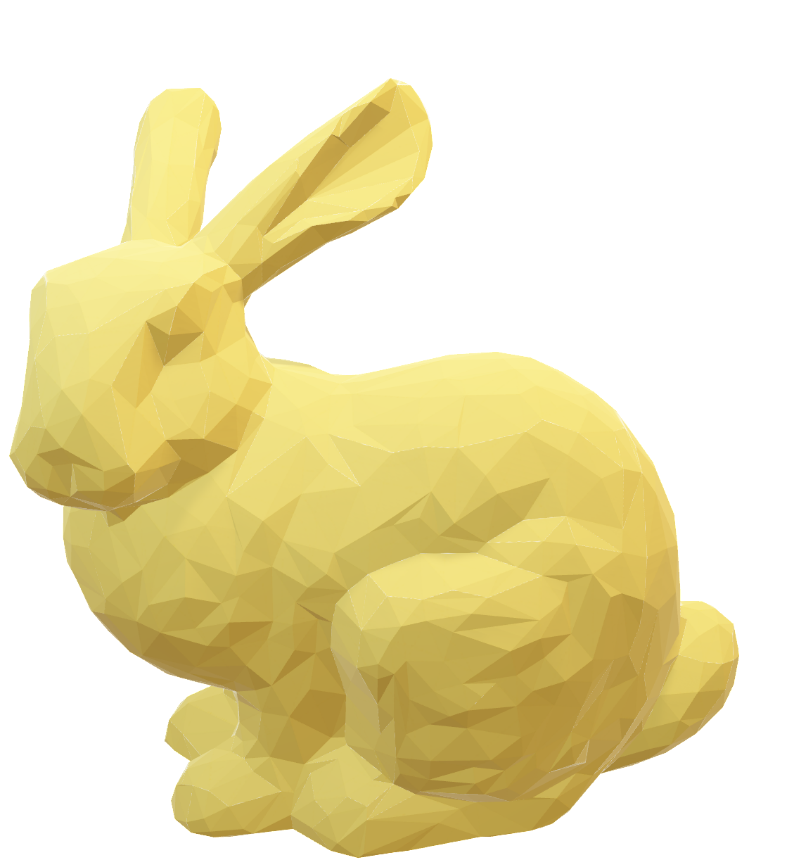
Intuitive 3D painting
Rotate manually to desired viewpoint, paint until satisfied
Rotate the model again and again
Notes:
3D texture painting is intuitive for designing hand-painted textures on 3D models, compared with painting directly on UV maps. In 3d painting, you rotate the model to desired viewpoint, paint the model, and iterate this process until you’re satisfied. Usually, choosing a viewpoint is done by rotating the model by mouse, but it’s difficult to get the desired viewpoint at once, and users usually end up in rotating the model again and again with their mouse.

Slide 3
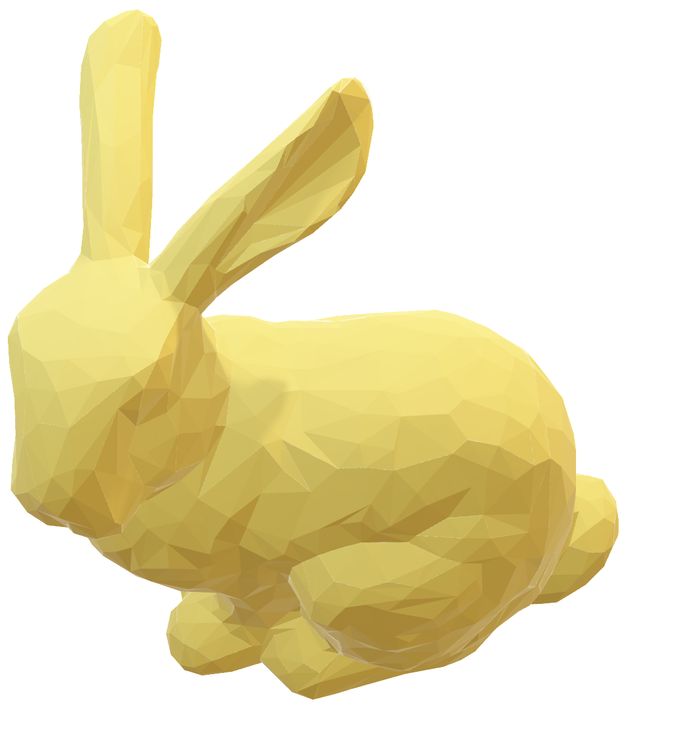
Intuitive 3D painting
Rotate manually to desired viewpoint, paint until satisfied
Rotate the model again and again
Notes:
3D texture painting is intuitive for designing hand-painted textures on 3D models, compared with painting directly on UV maps. In 3d painting, you rotate the model to desired viewpoint, paint the model, and iterate this process until you’re satisfied. Usually, choosing a viewpoint is done by rotating the model by mouse, but it’s difficult to get the desired viewpoint at once, and users usually end up in rotating the model again and again with their mouse.

Slide 4

Intuitive 3D painting
Rotate manually to desired viewpoint, paint until satisfied
Rotate the model again and again
Notes:
3D texture painting is intuitive for designing hand-painted textures on 3D models, compared with painting directly on UV maps. In 3d painting, you rotate the model to desired viewpoint, paint the model, and iterate this process until you’re satisfied. Usually, choosing a viewpoint is done by rotating the model by mouse, but it’s difficult to get the desired viewpoint at once, and users usually end up in rotating the model again and again with their mouse.

Slide 5
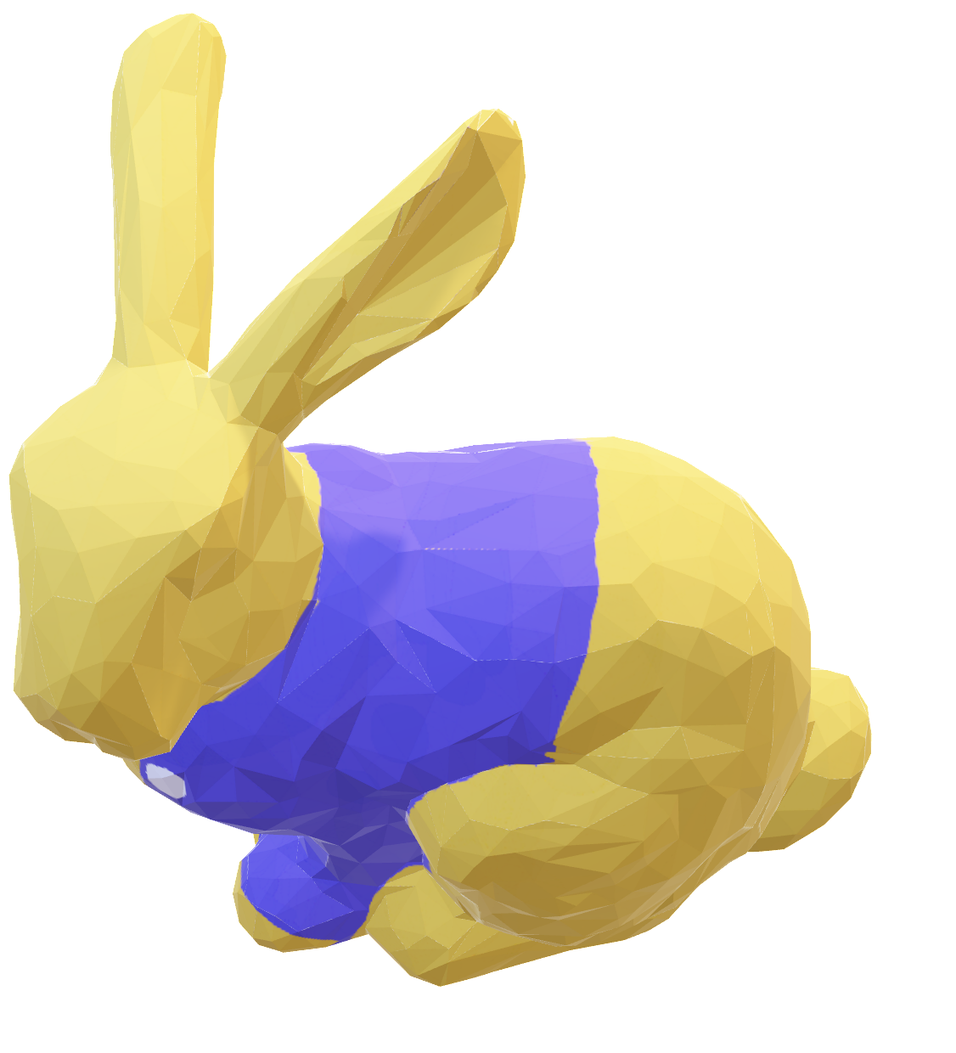
Intuitive 3D painting
Rotate manually to desired viewpoint, paint until satisfied
Rotate the model again and again
Notes:
3D texture painting is intuitive for designing hand-painted textures on 3D models, compared with painting directly on UV maps. In 3d painting, you rotate the model to desired viewpoint, paint the model, and iterate this process until you’re satisfied. Usually, choosing a viewpoint is done by rotating the model by mouse, but it’s difficult to get the desired viewpoint at once, and users usually end up in rotating the model again and again with their mouse.

Slide 6
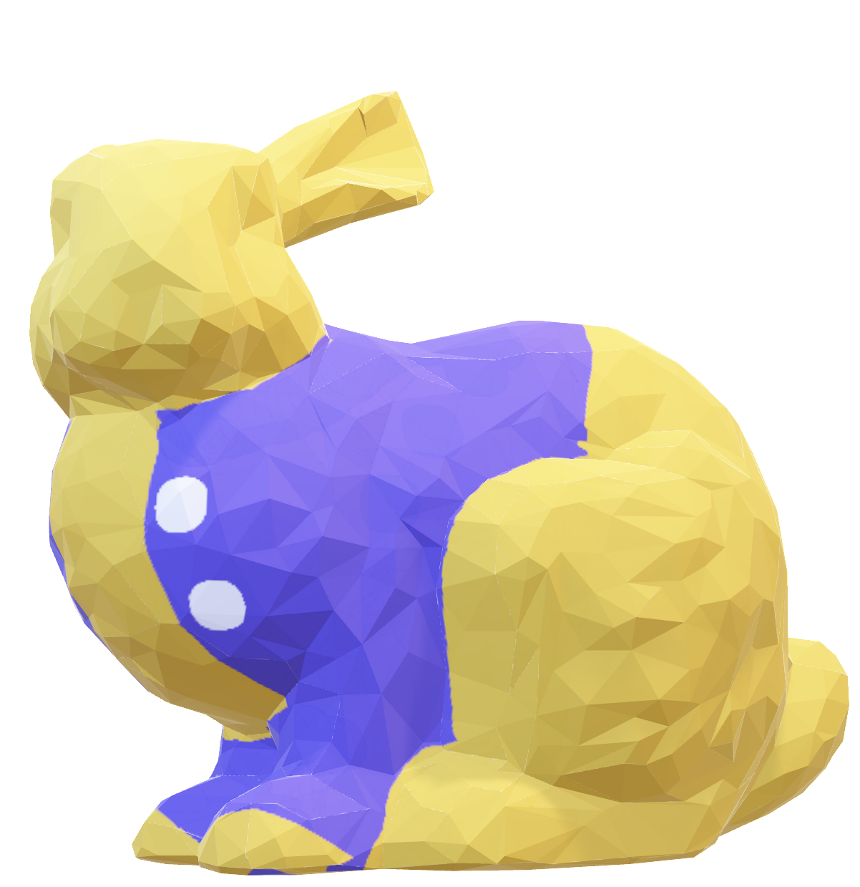
Intuitive 3D painting
Rotate manually to desired viewpoint, paint until satisfied
Rotate the model again and again
Notes:
3D texture painting is intuitive for designing hand-painted textures on 3D models, compared with painting directly on UV maps. In 3d painting, you rotate the model to desired viewpoint, paint the model, and iterate this process until you’re satisfied. Usually, choosing a viewpoint is done by rotating the model by mouse, but it’s difficult to get the desired viewpoint at once, and users usually end up in rotating the model again and again with their mouse.

Slide 7

Intuitive 3D painting
Rotate manually to desired viewpoint, paint until satisfied
Rotate the model again and again
Notes:
3D texture painting is intuitive for designing hand-painted textures on 3D models, compared with painting directly on UV maps. In 3d painting, you rotate the model to desired viewpoint, paint the model, and iterate this process until you’re satisfied. Usually, choosing a viewpoint is done by rotating the model by mouse, but it’s difficult to get the desired viewpoint at once, and users usually end up in rotating the model again and again with their mouse.

Slide 8
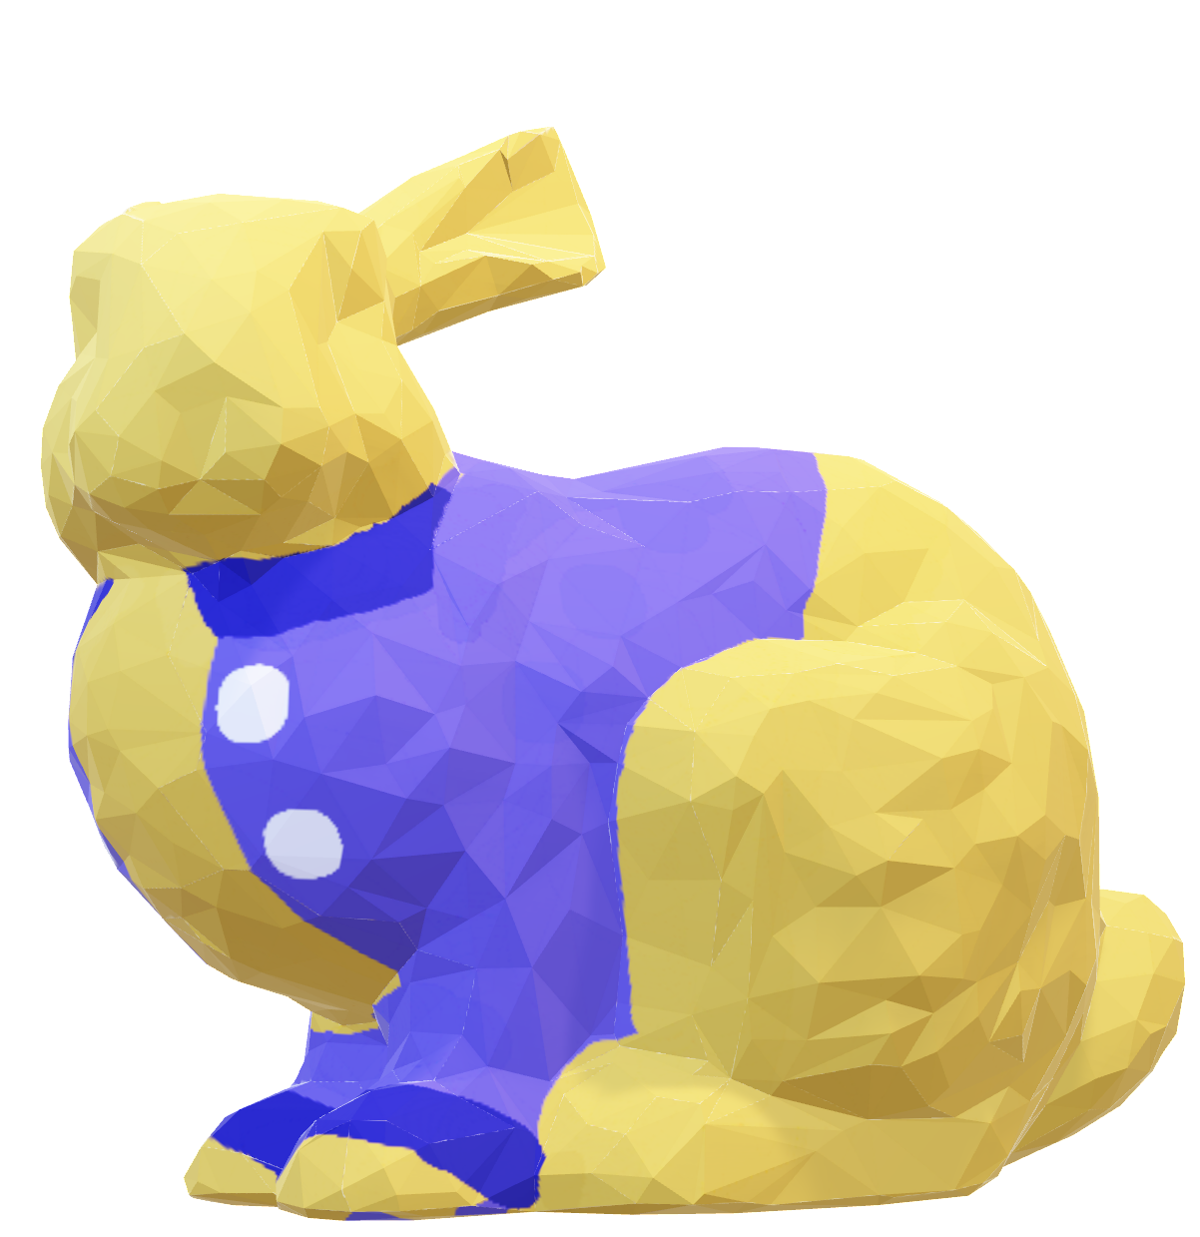
Intuitive 3D painting
Rotate manually to desired viewpoint, paint until satisfied
Rotate the model again and again
Notes:
3D texture painting is intuitive for designing hand-painted textures on 3D models, compared with painting directly on UV maps. In 3d painting, you rotate the model to desired viewpoint, paint the model, and iterate this process until you’re satisfied. Usually, choosing a viewpoint is done by rotating the model by mouse, but it’s difficult to get the desired viewpoint at once, and users usually end up in rotating the model again and again with their mouse.

Slide 9
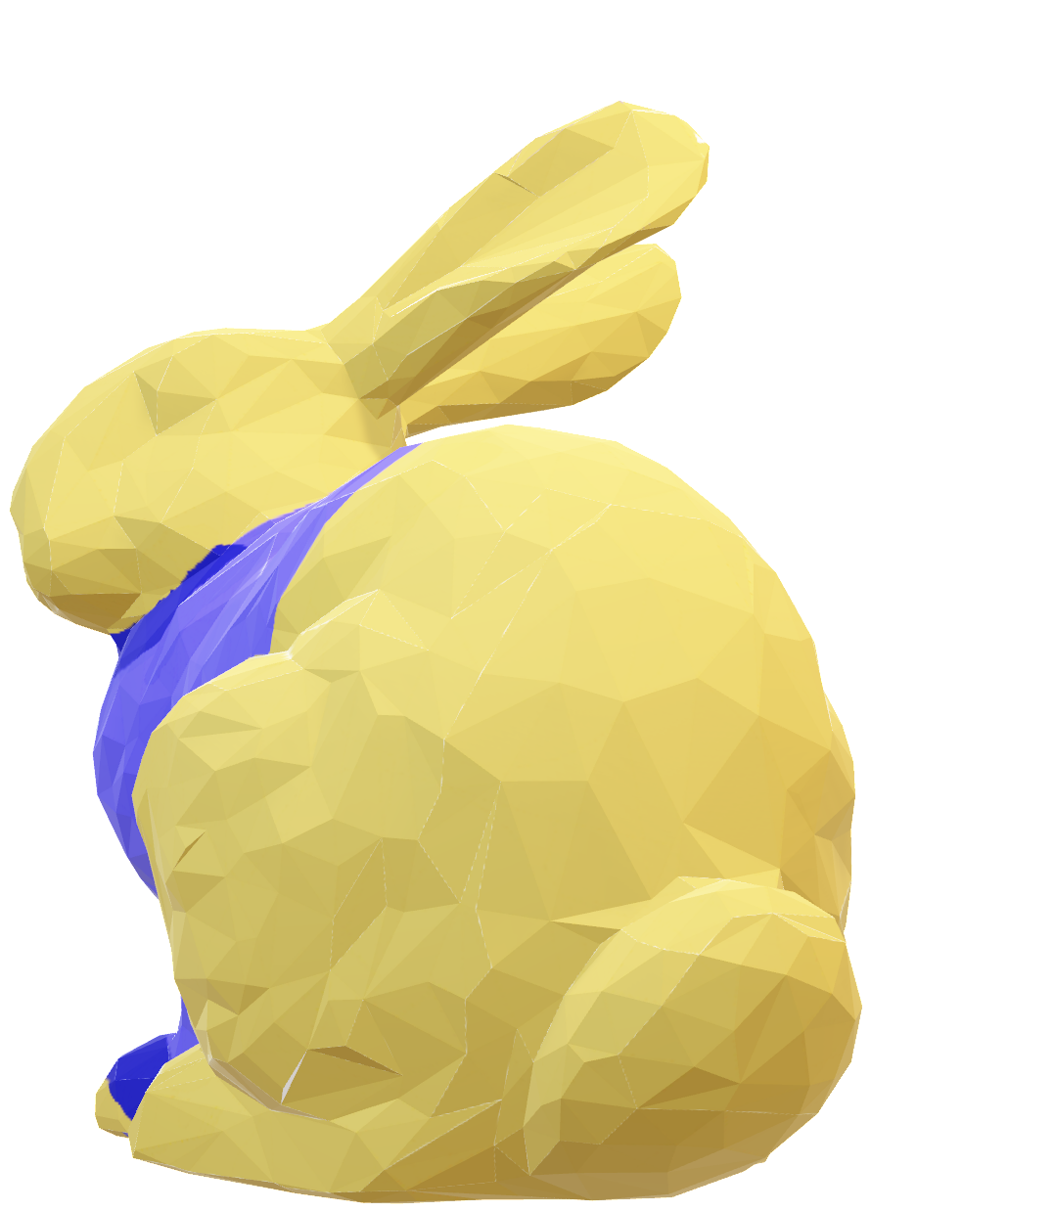
Intuitive 3D painting
Rotate manually to desired viewpoint, paint until satisfied
Rotate the model again and again
Notes:
3D texture painting is intuitive for designing hand-painted textures on 3D models, compared with painting directly on UV maps. In 3d painting, you rotate the model to desired viewpoint, paint the model, and iterate this process until you’re satisfied. Usually, choosing a viewpoint is done by rotating the model by mouse, but it’s difficult to get the desired viewpoint at once, and users usually end up in rotating the model again and again with their mouse.

Slide 10

Intuitive 3D painting
Rotate manually to desired viewpoint, paint until satisfied
Rotate the model again and again
Notes:
3D texture painting is intuitive for designing hand-painted textures on 3D models, compared with painting directly on UV maps. In 3d painting, you rotate the model to desired viewpoint, paint the model, and iterate this process until you’re satisfied. Usually, choosing a viewpoint is done by rotating the model by mouse, but it’s difficult to get the desired viewpoint at once, and users usually end up in rotating the model again and again with their mouse.

Slide 11
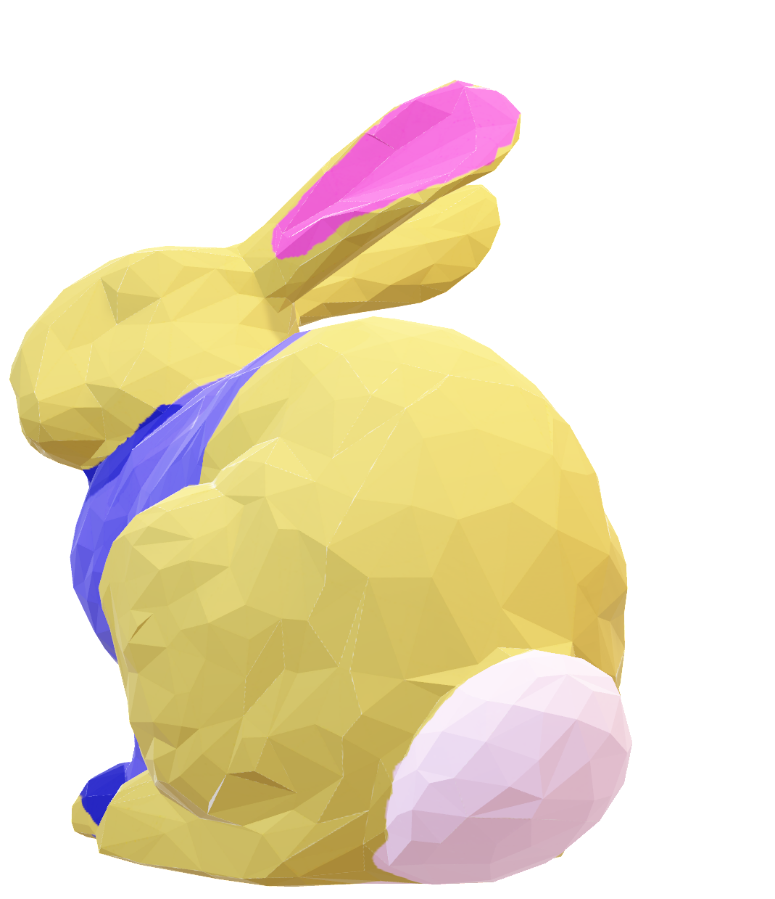
Intuitive 3D painting
Rotate manually to desired viewpoint, paint until satisfied
Rotate the model again and again
Notes:
3D texture painting is intuitive for designing hand-painted textures on 3D models, compared with painting directly on UV maps. In 3d painting, you rotate the model to desired viewpoint, paint the model, and iterate this process until you’re satisfied. Usually, choosing a viewpoint is done by rotating the model by mouse, but it’s difficult to get the desired viewpoint at once, and users usually end up in rotating the model again and again with their mouse.

Slide 12
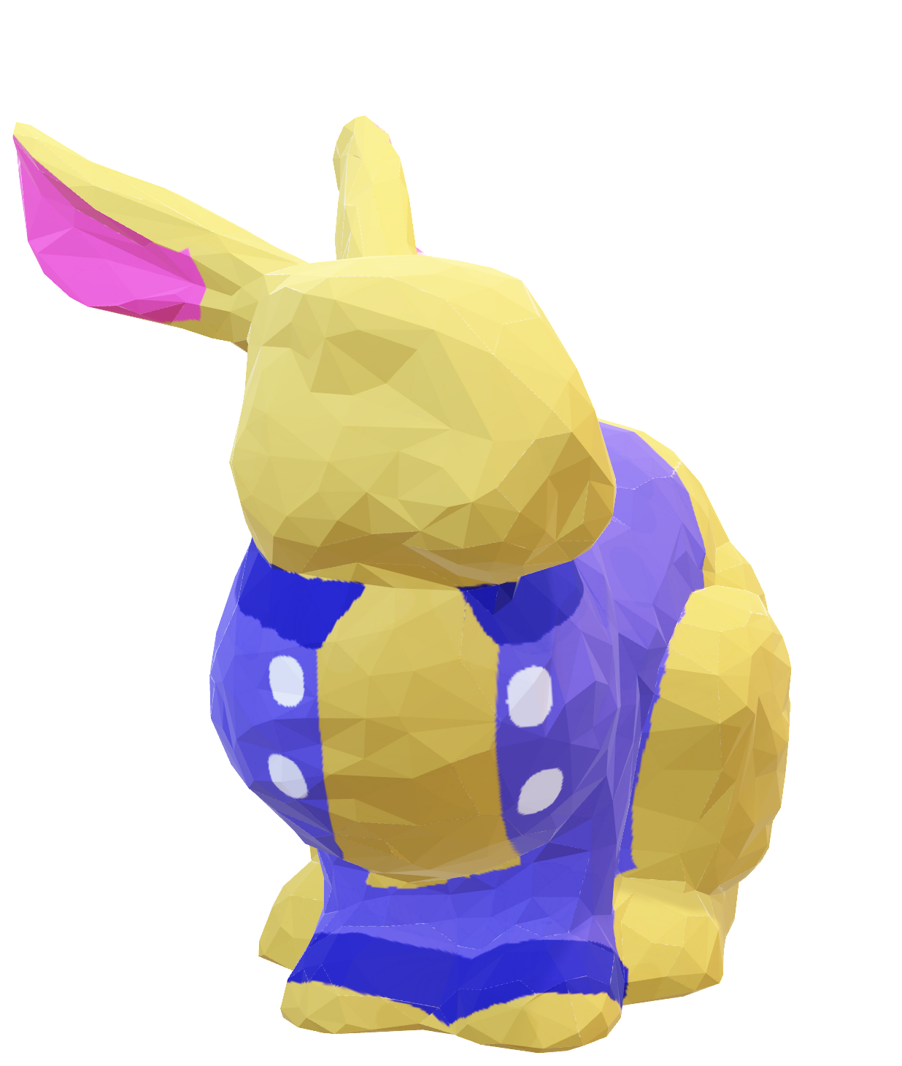
Intuitive 3D painting
Rotate manually to desired viewpoint, paint until satisfied
Rotate the model again and again
Notes:
3D texture painting is intuitive for designing hand-painted textures on 3D models, compared with painting directly on UV maps. In 3d painting, you rotate the model to desired viewpoint, paint the model, and iterate this process until you’re satisfied. Usually, choosing a viewpoint is done by rotating the model by mouse, but it’s difficult to get the desired viewpoint at once, and users usually end up in rotating the model again and again with their mouse.

Slide 13

Intuitive 3D painting
Rotate manually to desired viewpoint, paint until satisfied
Rotate the model again and again
Notes:
3D texture painting is intuitive for designing hand-painted textures on 3D models, compared with painting directly on UV maps. In 3d painting, you rotate the model to desired viewpoint, paint the model, and iterate this process until you’re satisfied. Usually, choosing a viewpoint is done by rotating the model by mouse, but it’s difficult to get the desired viewpoint at once, and users usually end up in rotating the model again and again with their mouse.

Slide 14
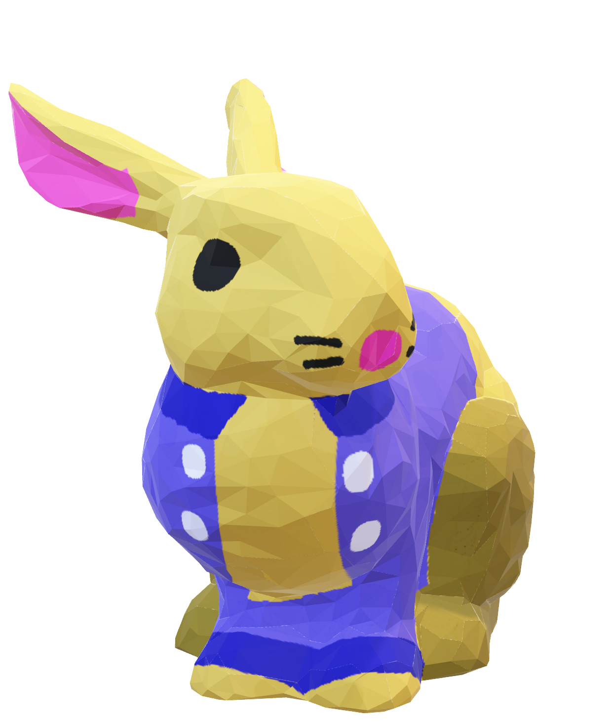
Intuitive 3D painting
Rotate manually to desired viewpoint, paint until satisfied
Rotate the model again and again
Notes:
3D texture painting is intuitive for designing hand-painted textures on 3D models, compared with painting directly on UV maps. In 3d painting, you rotate the model to desired viewpoint, paint the model, and iterate this process until you’re satisfied. Usually, choosing a viewpoint is done by rotating the model by mouse, but it’s difficult to get the desired viewpoint at once, and users usually end up in rotating the model again and again with their mouse.

Slide 15
Intuitive 3D painting
Rotate manually to desired viewpoint, paint until satisfied
Rotate the model again and again
Notes:
3D texture painting is intuitive for designing hand-painted textures on 3D models, compared with painting directly on UV maps. In 3d painting, you rotate the model to desired viewpoint, paint the model, and iterate this process until you’re satisfied. Usually, choosing a viewpoint is done by rotating the model by mouse, but it’s difficult to get the desired viewpoint at once, and users usually end up in rotating the model again and again with their mouse.

Slide 16
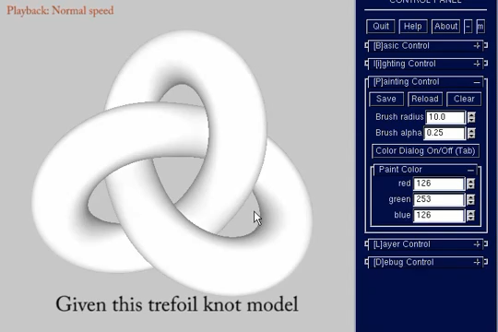
LayerPaint [Fu et al. CHI 2010]
Pop up the hidden region
multi-layer segmentation
Still need to manually rotate the model
Notes:
Many research has been conducted to address this issue.
LayerPaint automatically pops up the hidden region when the user-drawing stroke gets occluded, by multi-layer segmentation.
It is useful when you want to draw a stroke from a single viewpoint, but you still need to manually rotate the model if you want to change the viewpoint.

Slide 17
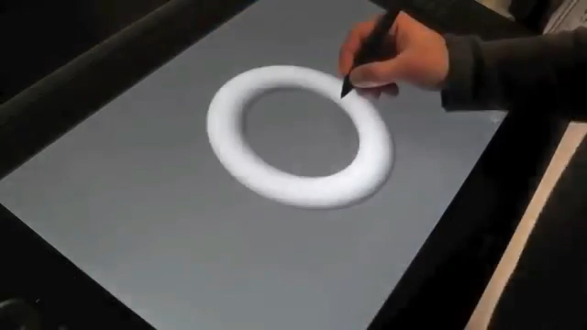
Direct drawing on 3D shapes with Automated Camera Control [Ortega and Vincent CHI 2014]
Long curves
Automated viewpoint control
Not applicable to 3D painting in general
Notes:
Ortega and Vincent proposed a tablet system for drawing long curves, with automated viewpoint control.
This system is useful for line drawing, but it’s not applicable to 3d texture painting in general where you don’t always want to draw the adjacent region with continuous stroke.

Slide 18
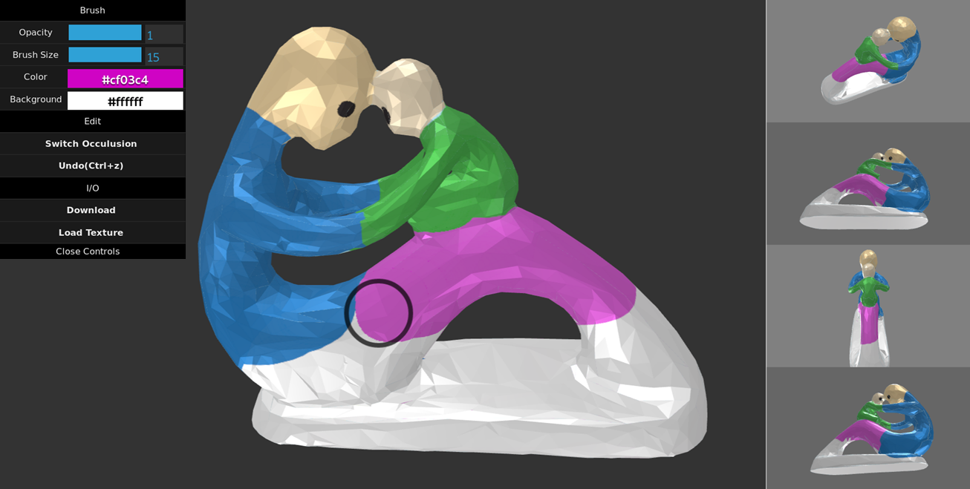
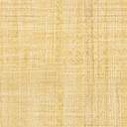
Our Method
Notes:
Let’s move on to our method,

Slide 19
user’s painting
Notes:
In paintersview system, users can paint textures on a model, like this,

Slide 20
viewpoints selection
Notes:
And optimal viewpoints are automatically presented as shown

Slide 21
viewpoints selection
Notes:
Users can click the desired next viewpoint from suggestions, and the viewpoint will be updated accordingly.

Slide 22

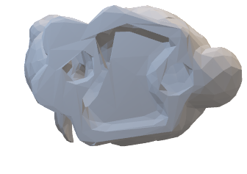

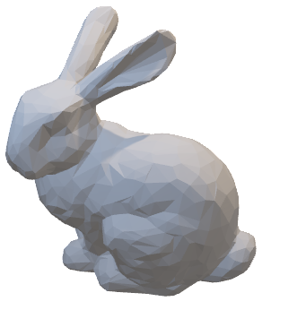
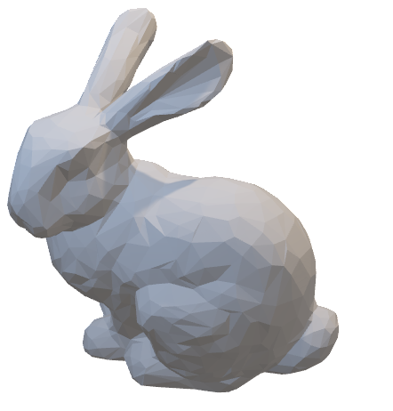
Good Viewpoint Criteria (In short)
Many front facing faces from the view
Many unpainted region in the view
Good Viewpoint
Bad Viewpoint
Front facing faces
Unpainted
Few front facing faces
Already painted
Notes:
So how do we choose the best viewpoints? We’ll soon show details, but in short, we assume that optimal viewpoint fulfill the criteria of having many front facing and unpainted faces in its view. On the other hand, bad viewpoints have few front facing faces, and many of those are already painted.

Slide 23
Demo
Notes:
Now, we’ll show you a demo of PaintersView..

Slide 24


Contribution
A novel concept to interactively suggest optimal viewpoints for the 3D painting task
A simple yet effective algorithm to estimate optimal viewpoints using information from 3D geometry and a current texture
 | No manual rotation | Pop up the hidden region | Supports 3D painting in general
Fu et al.
Ortega and Vincent
PaintersView
Notes:
For our contribution, we present “A novel concept to interactively suggest optimal viewpoints for the 3D painting task”, and “A simple yet effective algorithm to estimate optimal viewpoints using information from 3D geometry and a current texture”.
Compared with previous works, PaintersView is a system which reduces manual viewpoint operation for 3D painting in general.

Slide 25
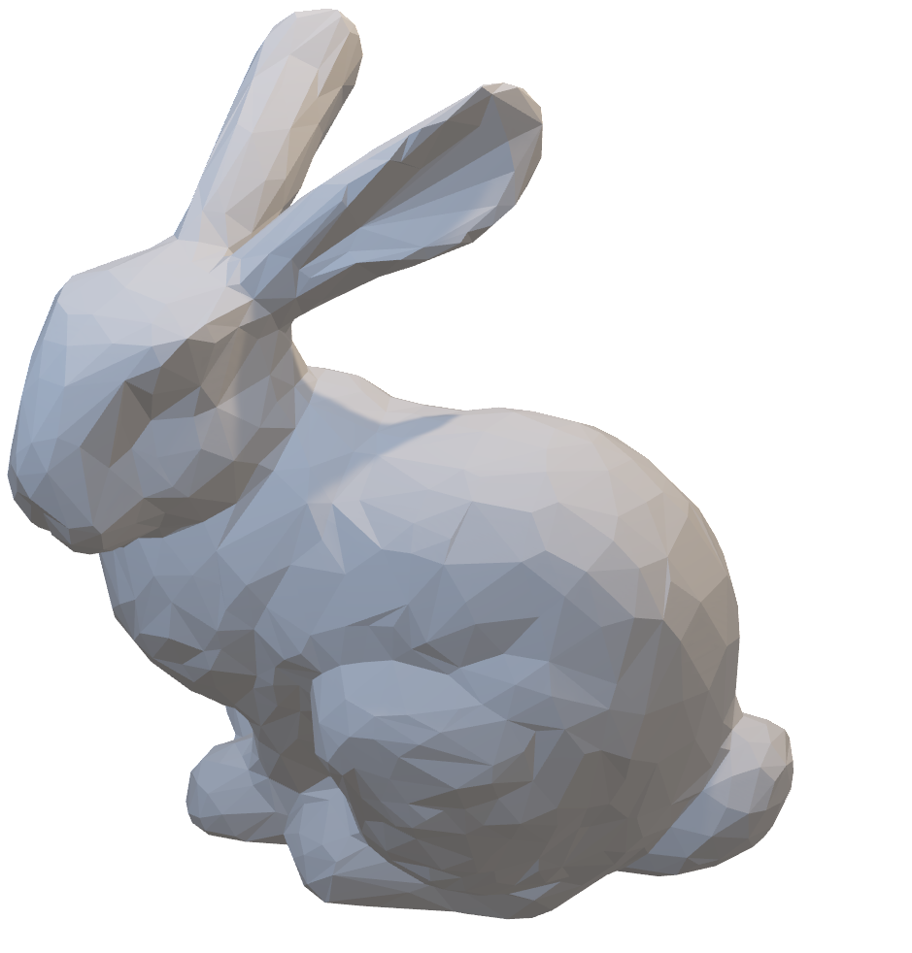
Viewpoint Initialization
N=70
Uniformly sample around the input model
Notes:
To begin with, we initialize viewpoints by uniformly sampling 70 viewpoints around the input model.

Slide 26
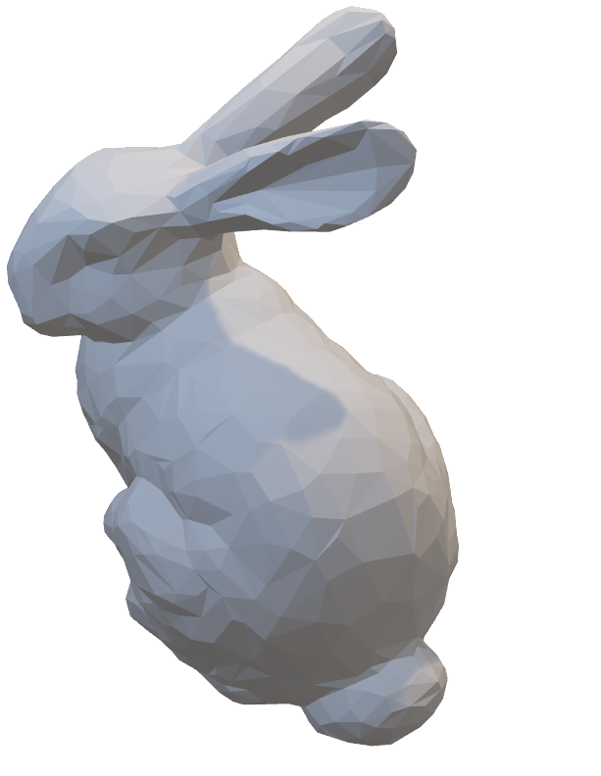

Viewpoint Initialization
N=70
Uniformly sample around the input model
Notes:
For example, from this viewpoint with a red circle, you can see the model like this,

Slide 27
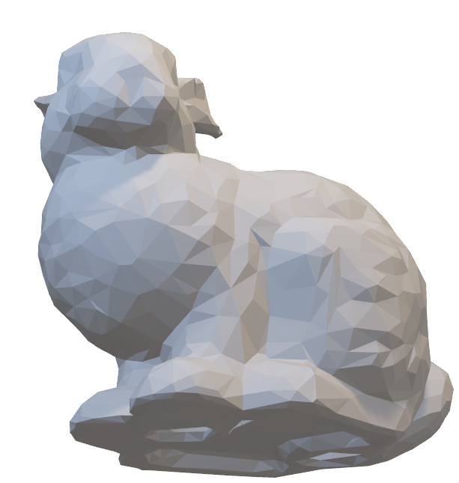
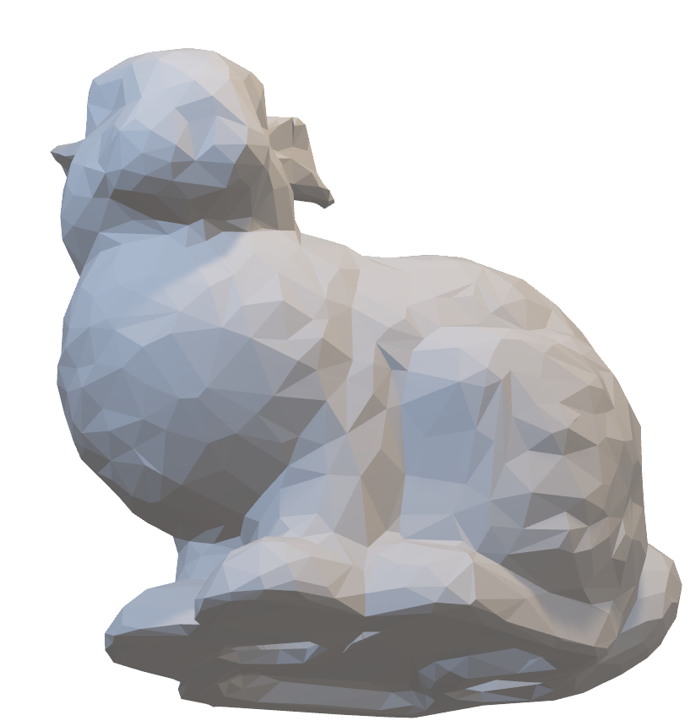
Viewpoint Initialization
N=70
Uniformly sample around the input model
Notes:
And from this viewpoint, you can see the bottom of the bunny.

Slide 28
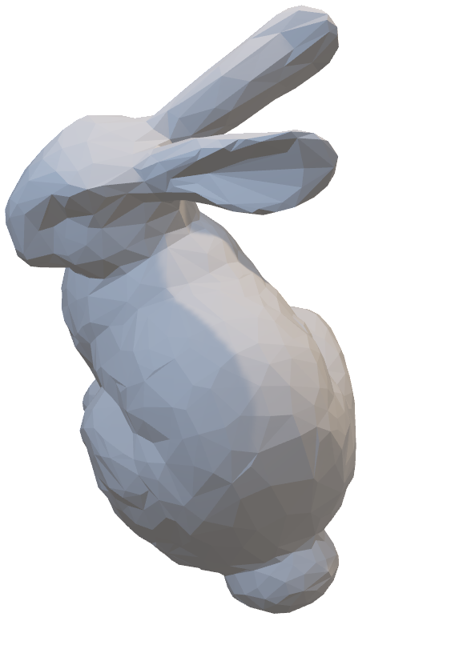
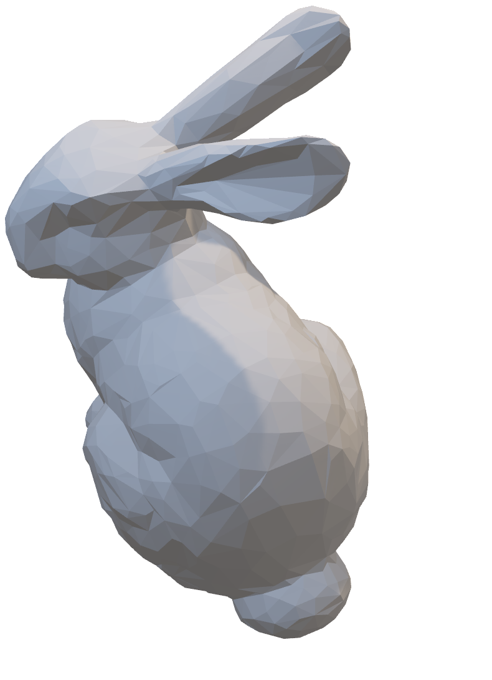
Viewpoint Function
For each viewpoints:
: Geometry information
: Current texture painting
= 0.04 (empirically)
Notes:
For each of these viewpoints, we calculate this energy function. Egeometry corresponds to an energy term from geometry information, and Epaint is an energy term from current texture painting. W is a weight value for tweaking the balance between Egeometry and Epaint. In this paper, we empirically found that 0.04 provided a good balance.

Slide 29
Optimization Problem
Notes:
Using this energy function, optimization problem can be defined like this, which means,

Slide 30
Optimization Problem
From all initialized viewpoints
Notes:
From all initialized viewpoints,

Slide 31
Optimization Problem
Take one which maximizes the energy function
Notes:
Take one which maximizes the energy function.

Slide 32
Geometry Term
Objective: Prefer the viewpoint with more visible horizontal faces
: Faces visible
from the viewpoint
Face normal
Direction vector from the viewpoint camera to the model
Notes:
Let’s look deeper into the geometry term. The objective of Egeometry is to maximize the number of visible faces from the viewpoint.
Fi is a set of faces visible from the i-th viewpoint, nf is a face normal, and di is a direction vector from the viewpoint camera to the model. We simply take the sum of the product of nf and di, to maximize the number of visible faces from the i-th viewpoint.

Slide 33
Current Texture Term
Objective: Prefer the viewpoint with more unpainted faces
: unpainted area of
in UV texture
UV Mapping of
Notes:
For Epaint term, the objective is to prefer the viewpoint with more unpainted faces.
We calculate the sum of unpainted areas of Fi. Upaint is the unpainted area of f in UV texture.
This is a simple heuristic, but it is capable to prefer the view with more unpainted areas.

Slide 34
Four Viewpoint Selection
viewpoints selection
Notes:
After calculating those functions for each viewpoint, we suggest four viewpoints on the right-hand side pane, where users can choose from them.

Slide 35
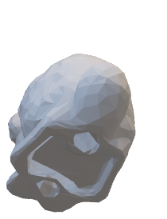
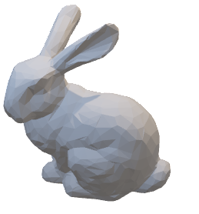
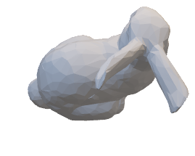
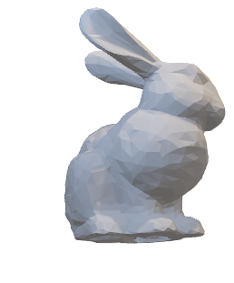
Four Viewpoint Selection
Score
= 19.3
27.1
2.53
32.0
Notes:
We first calculate the score from the energy function,

Slide 36
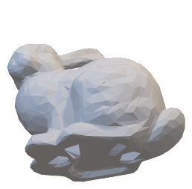
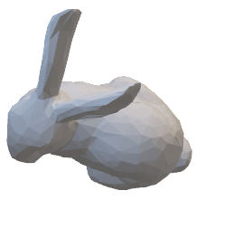
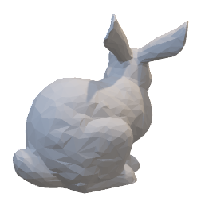
Four Viewpoint Selection
Score
32.0
27.1
20
19.3
Greedy
Minimum overlap of visible faces
2.53
Notes:
Sort them in descending order, and first choose the top racked candidate, for example the one with score 32.0 in this case. For remaining candidates, we take top 20 viewpoints and greedily pick the one which has minimum overlap of visible faces with already picked candidate.

Slide 37
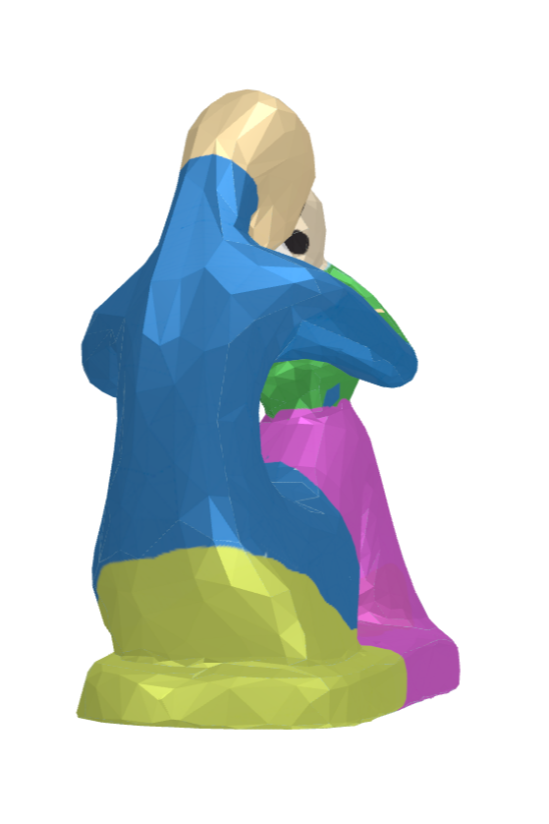
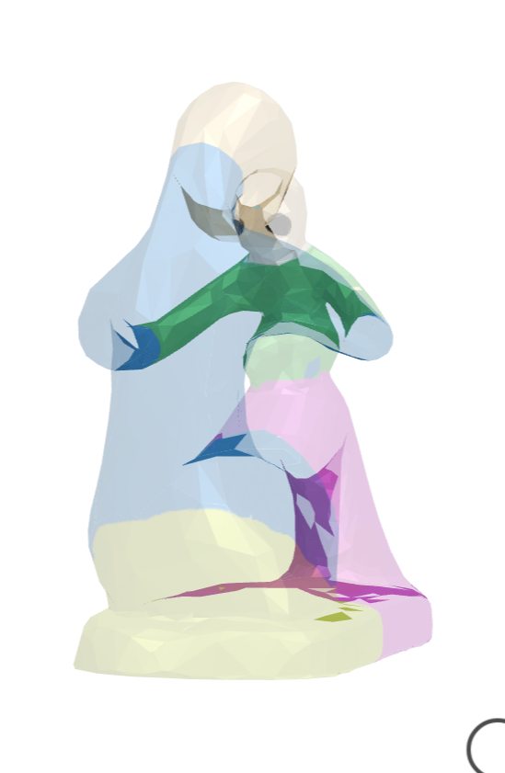
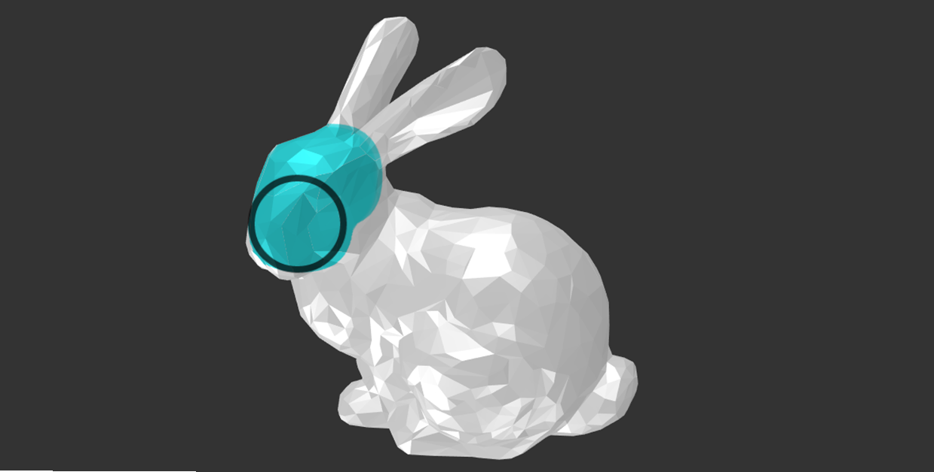

User Interaction
Annotation Tool
Occlusion Access Tool
Users switch to make front-most faces translucent
Limit
to annotated faces
Notes:
We also implemented auxiliary user interaction tools. It’s not necessary, but users can use them if they wish.
* Annotation Tool lets users to specify the target region in the model, and the viewpoints will be limited to those which contain the user annotated faces.
* Occlusion Access Tool was inspired by Layerpaint, and it allows users to make front-most faces translucent and directly draw on the occluded areas.

Slide 38
User Study
Task1: Manual Control vs Our Method
Task2: without (w/o) Epaint term vs with (w/) Epaint term
6 participants
Aged from 20 to 30 years old
Casual users who had at least one year’s experience with 3D or painting software
Notes:
We conducted two user studies.
Task 1 aims to compare our method with the fully manual setting of viewpoints, and Task 2 aims to assess the effectiveness of Epaint term by using only Egeometry term for optimization.
We recruited six participants, all ages from 20 to 30 years old. All participants were casual users who had at least one year’s experience with 3D or painting software.

Slide 39


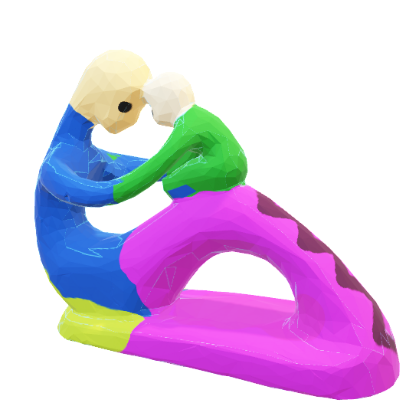

Task1: Manual Control vs Our Method
Example:
Two unpainted models
A torus model and a fertility model
Asked users to perform 3D painting, using the example as a reference
Notes:
We provided participants with two unpainted models (a torus model and a
fertility model) and asked them to perform 3D painting, using those example as a reference.

Slide 40
Task1: Manual Control vs Our Method
: Manual
: Our Method
Positive
16.7
16.7
4.50
3.92
83.3
83.3
2.75
2.58
Negative
Torus
Fertility
Torus
Fertility
Q1: More comfortable?
Q2: Over all usability
Notes:
After completing these tasks, all participants were asked to answer two questions. Question 1, Which did you find was more comfortable to use for design? And question 2, Score the overall usability of each method. The second question was in range of 1 to 5, with 1 being extremely dissatisfied and 5 being extremely satisfied.
In question 1, 83.3% of participants preferred our method over manual viewpoint selection in both torus and fertility model.
Usability score average in question 2 was also higher with our method.

Slide 41
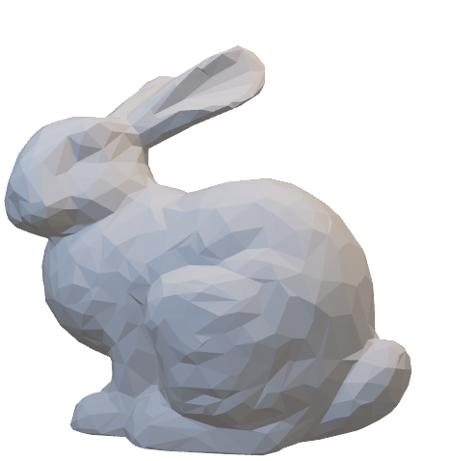

Task1: Manual Control vs Our Method
Average of manual control and viewpoint selection operation
Manual Control
Viewpoint Selection Operation
Notes:
We also measured the number of manual control operation and viewpoint selection operation. Manual control is a rotating operation by mouse like this,

Slide 42
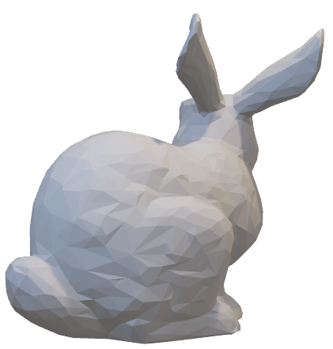
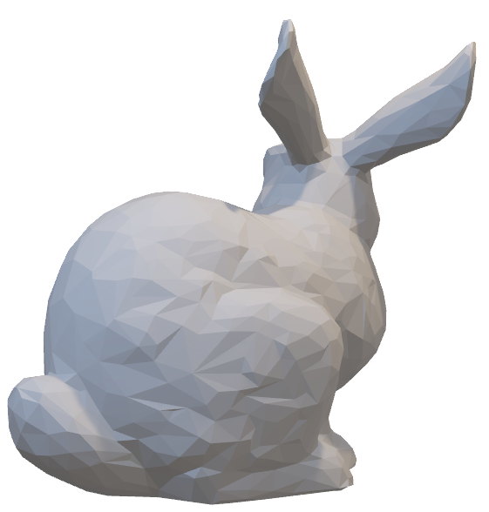
Task1: Manual Control vs Our Method
Average of manual control and viewpoint selection operation
Manual Control
Viewpoint Selection Operation
Notes:
And viewpoint selection operation is an action of selecting a viewpoint with our method, by clicking it.

Slide 43
Task1: Manual Control vs Our Method
Viewpoint Selection Operation
: Manual
: Viewpoint Selection
75.7
25.3
16.1
manual
our system
Average of manual control and viewpoint selection operation
Notes:
As a result, the average number of manual operation was 75.7 with manual control task. It was 16.1 with our system, plus 25.3 times of viewpoint selection. From this result, it is likely that paintersview reduces the number of repetitive operations.

Slide 44
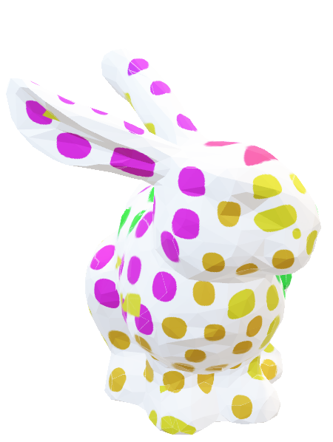

Task2: w/o Epaint vs w/ Epaint
Example:
One unpainted model (Bunny)
Asked users to perform 3D painting, using the example as a reference
Notes:
Task 2 is the user study to assess the effectiveness of Epaint term. Without Epaint term task is the same as our proposed system but without updating viewpoint suggestion after each texture painting. So the viewpoint suggestion will become static as it only uses geometry term.
We provided participants with unpainted bunny model and asked them to perform 3D painting, using the example as a reference.

Slide 45
Task2: w/o Epaint vs w/ Epaint
: w/o Paint Feature
: with Paint Feature
Positive
33.3
66.7
4.00
3.17
Negative
Q1: More comfortable?
Q2: Over all usability
Notes:
We asked the same question as Task1 after the participants completing the Task 2.
Although the difference in the degree of preference was not as large as task 1, many users still preferred having automatic update from current texture information.

Slide 46
Task2: w/o Epaint vs w/ Epaint
Viewpoint Selection Operation
: Manual
: Viewpoint Selection
16.6
16.7
5.4
2.83
w/o Epaint
w/ Epaint
Average of manual control and viewpoint selection operation
Notes:
The average number of manual operation was 5.4 without Epaint, and 2.8 with Epaint. The number of viewpoint selection was almost the same.

Slide 47
Comments (Summary)
P1: It was easier to interactively find best viewpoints without slight adjustments.
P2: The viewpoint candidates are very useful for understanding the shape of the 3D models and current textured results at painting time.
P3: I wanted to directly customize the viewpoint candidates, for example, the opposite side of the current viewpoints.
Notes:
These are summarized qualitative comments from participants.
P1 told us that interactive update with Epaint term was useful, and P2 told that the viewpoints candidates were very useful for understanding the shape of 3D models and current textured results at painting time.
However, P3 was not fully satisfied with our system, and told that he wanted to directly customize the viewpoint candidates, not fully automatic.

Slide 48
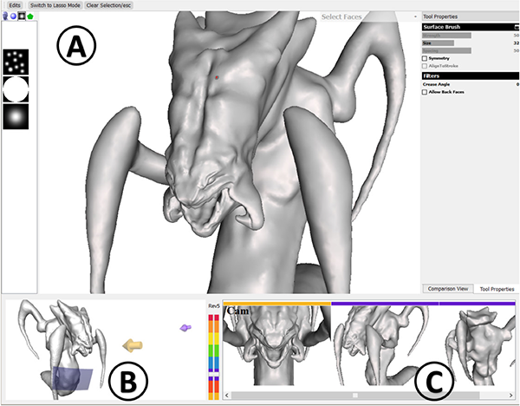

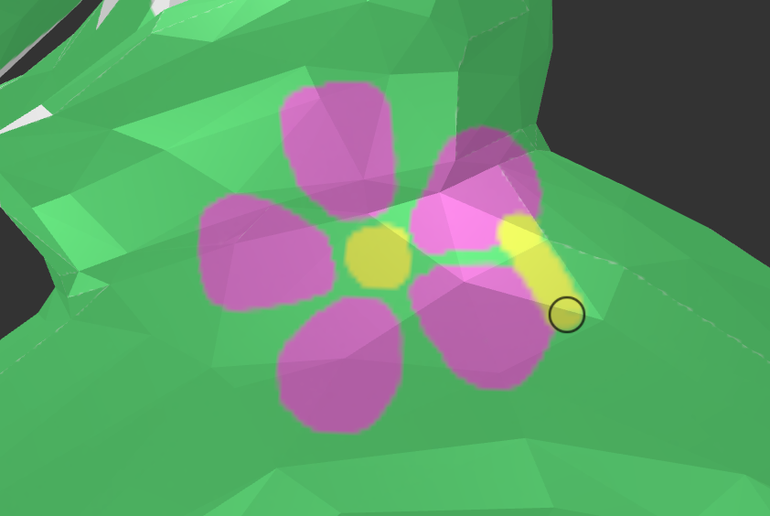


Limitations/Future Work
Refine when the pixel color is different from neighbors
Utilize history for viewpoint suggestion
History Assisted View Authoring for 3D Models
[Chen et al. CHI 2014]
Support multi-layer texture painting
Notes:
The limitation of this system, is that any painted region is marked as “done” for Epaint term, so our system fails to consider mistakes, like this, or when you want to draw in addition to the current painting. We think that it can automatically refine the wrongly painted regions when the painted pixel color is different from neighbors.
Also, we think that history from users’ past operation can be used to make suggestions more personalized, using similar method as “History Assisted View Authroing for 3D Models”.
Finally, current system only supports a single layer texture painting, so it will be useful to add multi-layer support.

Slide 49
Conclusion
: Manual
: Our Method
16.7
83.3
Task 1 Q1
Find the next viewpoints for drawing on the unpainted areas
Optimization function using geometry and intermediate paint results
The proposed system was rated higher on average by user study
Notes:
In conclusion, we proposed an interactive system to find the next viewpoints for drawing on the unpainted areas
We utilize Egeometry term from geometry information, and Epaint term from intermediate texture information.
The proposed system was rated higher on average in the user study.

Slide 50
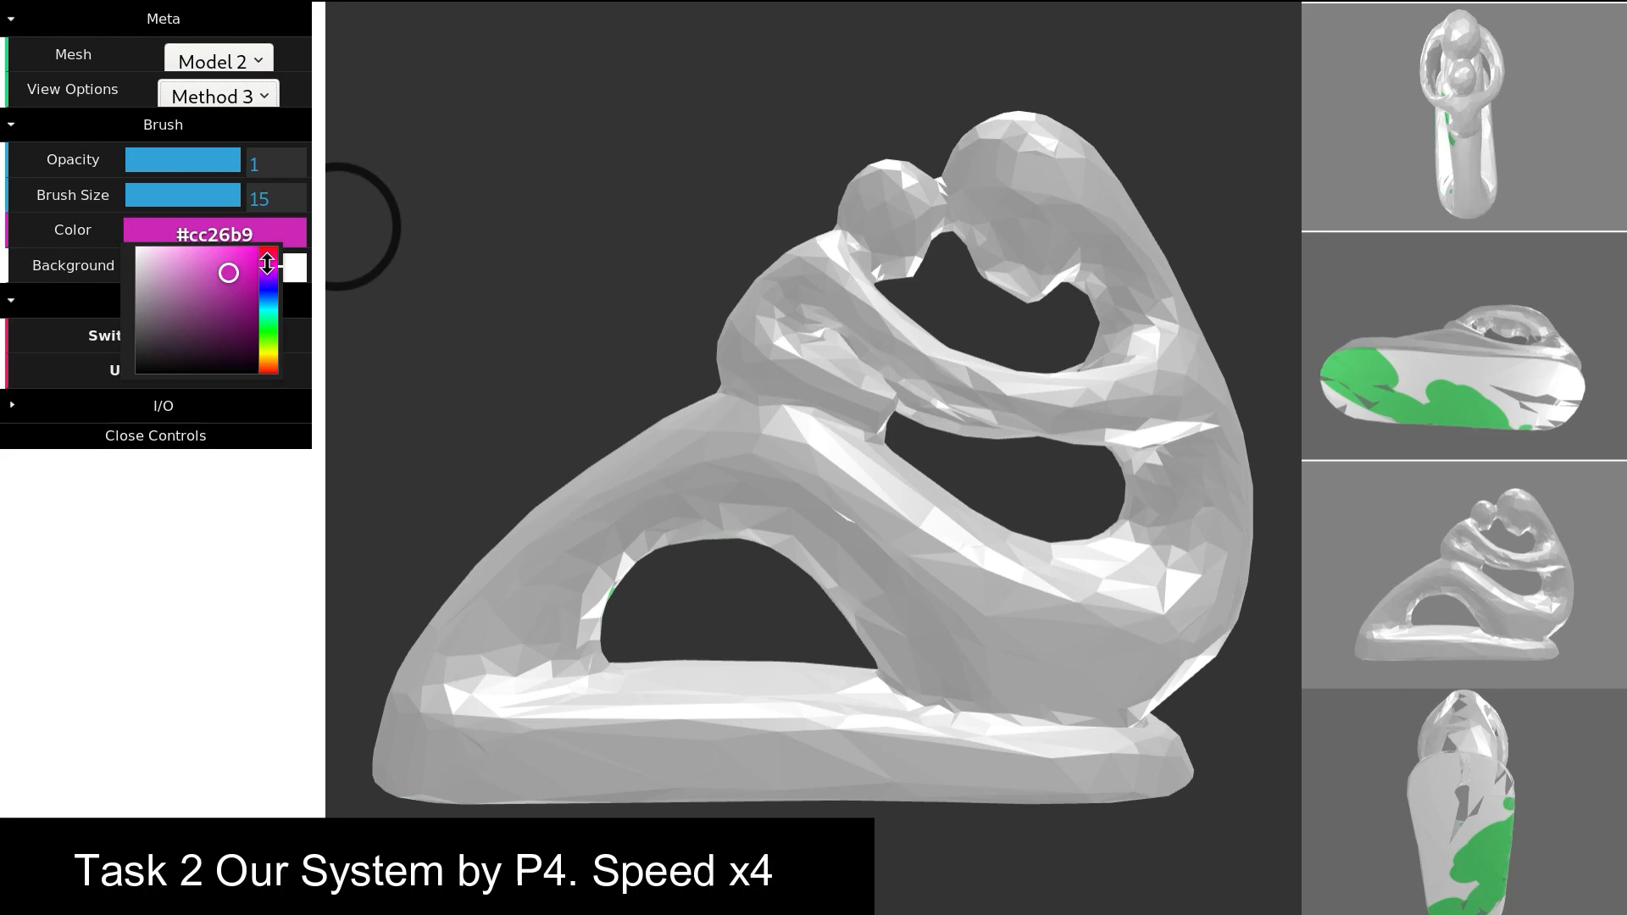
Acknowledge
This work was supported by JSPS KAKENHI grant No. JP17H00752 & JP19K20316, Japan.
T1 Fertility
Notes:
Thank you for your attention! Any questions?

Slide 51
Backup Slides
Notes:
This is the same person, participant 4, using our system.
..
Right hand side pane shows viewpoint suggestions from the system, and the user is choosing one as he draws.

Slide 52
T1 Fertility
Notes:
This is the same person, participant 4, using our system.
..
Right hand side pane shows viewpoint suggestions from the system, and the user is choosing one as he draws.

Slide 53
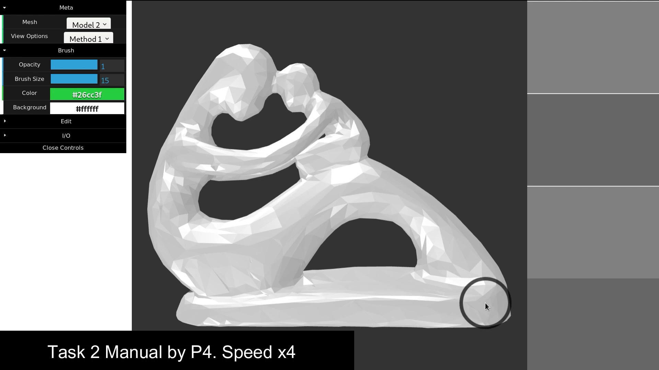
T1 Fertility
Notes:
Here is the screen capture of task 1 manual control by participant 4.
...
As you can see, participant 4 is rotating the model by mouse as he draws the model.

